Slide 1
IST 654 Information Systems Analysis
Team 5:
Akshitha Reddy
Pooja Kasar
Shrey Sheth
Vedant Patil
Akshitha Reddy Pooja Kasar Shrey Vedant Patil

Slide 2

Final Project Presentation
Human Resource Management System for TechNova

Slide 3
Executive Summary
TechNova, a consulting company, can benefit greatly from implementing a Human Resource Management System to streamline their HR processes and improve employee management
This system will provide a centralized database of employee information, making it easy for HR personnel to access and manage employee data, such as personal details, job descriptions, performance records, and other important information. It will also automate several HR tasks, such as employee onboarding, performance appraisals
Additionally, the HRMS will facilitate communication between HR and employees through self-service portals
The HRMS will also provide valuable insights into the workforce, allowing HR personnel to track employee performance, department performance, and generate reports on key HR metrics which will help the HR analyze the performance of teams and further provide the trip benefits to the employees

Slide 4
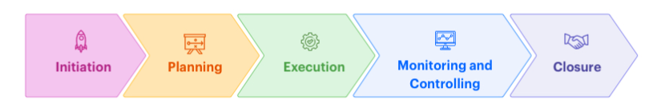
Project Overview
The project will go through the following phases:
Gathering requirements
System design
Development
Testing
Deployment
Training
Agile project management

Slide 5
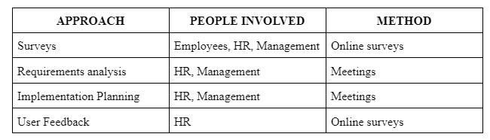
Data Collection Approach

Slide 6
Functional Requirements
Employee Information Management
Payroll Processing
Time and Attendance Tracking
Reporting and Analytics
Performance Management

Slide 7
Non-Functional Requirements
Security
Usability
Performance
Compliance
Maintainability

Slide 8
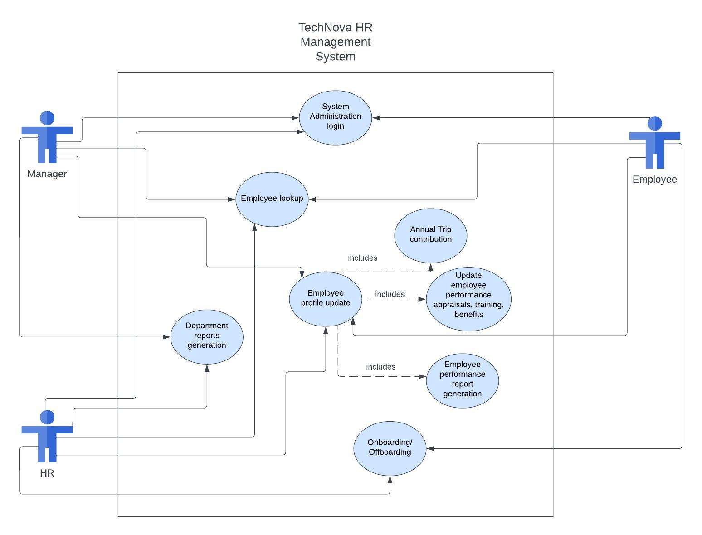
Use Case

Slide 9
Use Case Glossary
Use-Case number | Use Case ID | Use-case Description | Actors
1 | System Administration login | Allows employees,HR,Managers to log in to the HRMS system to view and update their personal information, submit leave requests, and view their performance records. | Manager, HR, Employee
2 | Employee lookup | Employees,HR and managers will be able to access the system to view and update their personal/professional information, request time off, view their pay stubs, and enroll in benefits. | Manager, HR, Employee
3 | Employee profile update | The HRMS system enables employees to access their personal information, request time off, and review their performance records by logging in to their accounts. They can also update their personal information through the system. | Manager, HR, Employee

Slide 10
Use Case Glossary
Use-Case number | Use Case ID | Use-case Description | Actors
4 | Department reports generation | Department reports generation refers to the process of generating reports that provide information about the performance and activities of a particular department within an organization. | Manager, HR
5 | Annual Trip contribution | The HRMS system will monitor both employee information and their contributions towards the Annual Trip initiative. | Manager, HR, Employee
6 | Update employee performance appraisals, training, benefits | The system will allow for setting performance goals and tracking progress, as well as conducting performance reviews and providing feedback to employees. | HR
7 | Employee performance report generation | The system will generate reports and provide data analytics to help HR make informed decisions, such as employee turnover rates, performance trends, and benefits costs. | Manager, HR
8 | Onboarding/ Offboarding | The HRMS system will offer features to manage employee departures, which includes conducting exit interviews and monitoring the return of company assets. Additionally, it will guide HR staff through the process of welcoming new employees by verifying their personal details, assigning job roles, configuring payroll, and delivering any required training. | HR, Employee

Slide 11
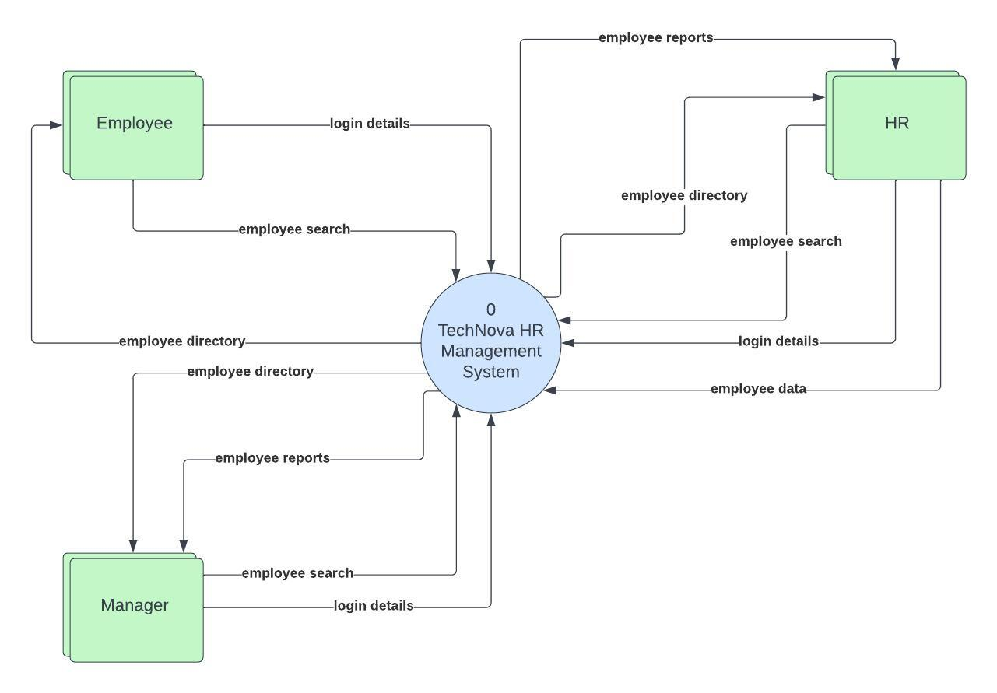
Data Flow Diagram

Slide 12
Economic Feasibility
Equipment | Approximate Cost
Server | $2,000 - $10,000
Network Switch | $500 - $1,500
Storage Device | $1,000 - $5,000
Workstations | $500 - $2,000
Printers | $200 - $1,000
Scanners | $200 - $1,000
Routers | $500 - $1,500
Backup Systems | $2,000 - $10,000
Firewall | $1,000 - $5,000
Uninterruptible Power Supply | $500 - $2,000

Slide 13
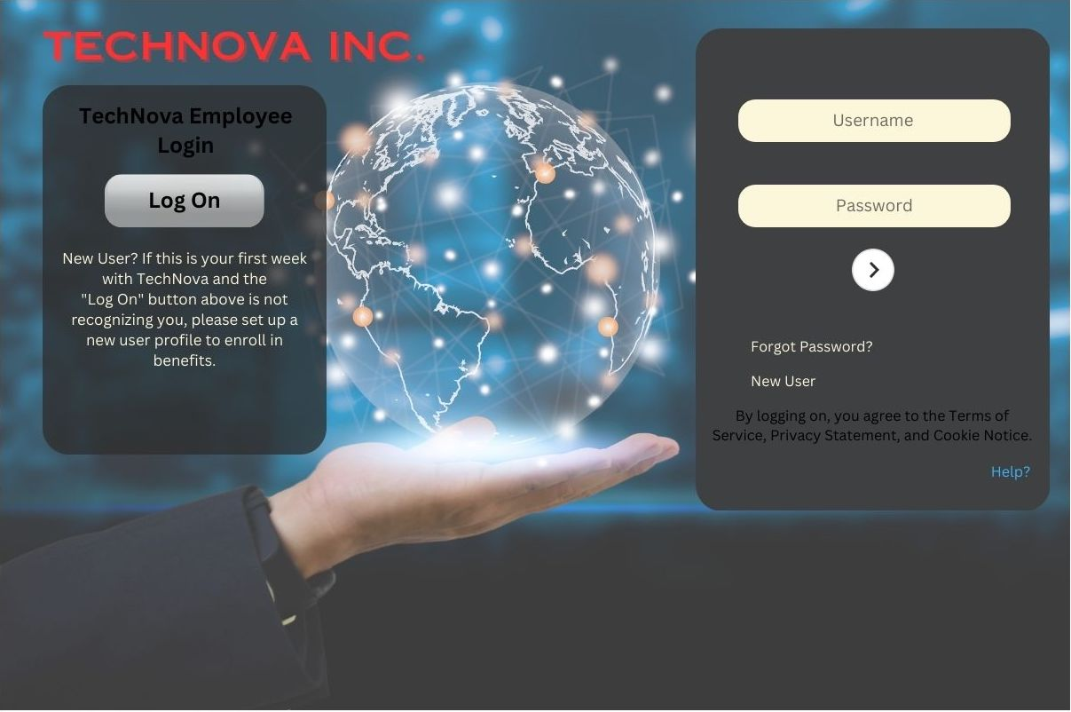
Interfaces

Slide 14
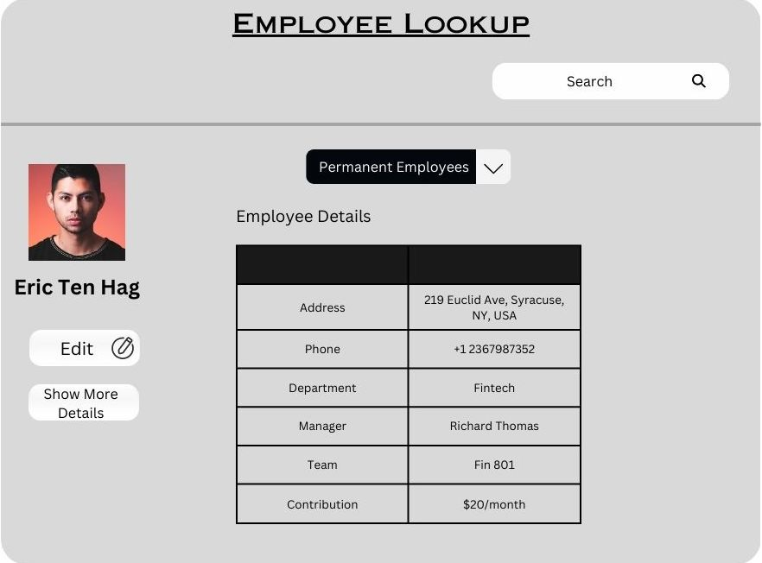
Employee Lookup Interface

Slide 15
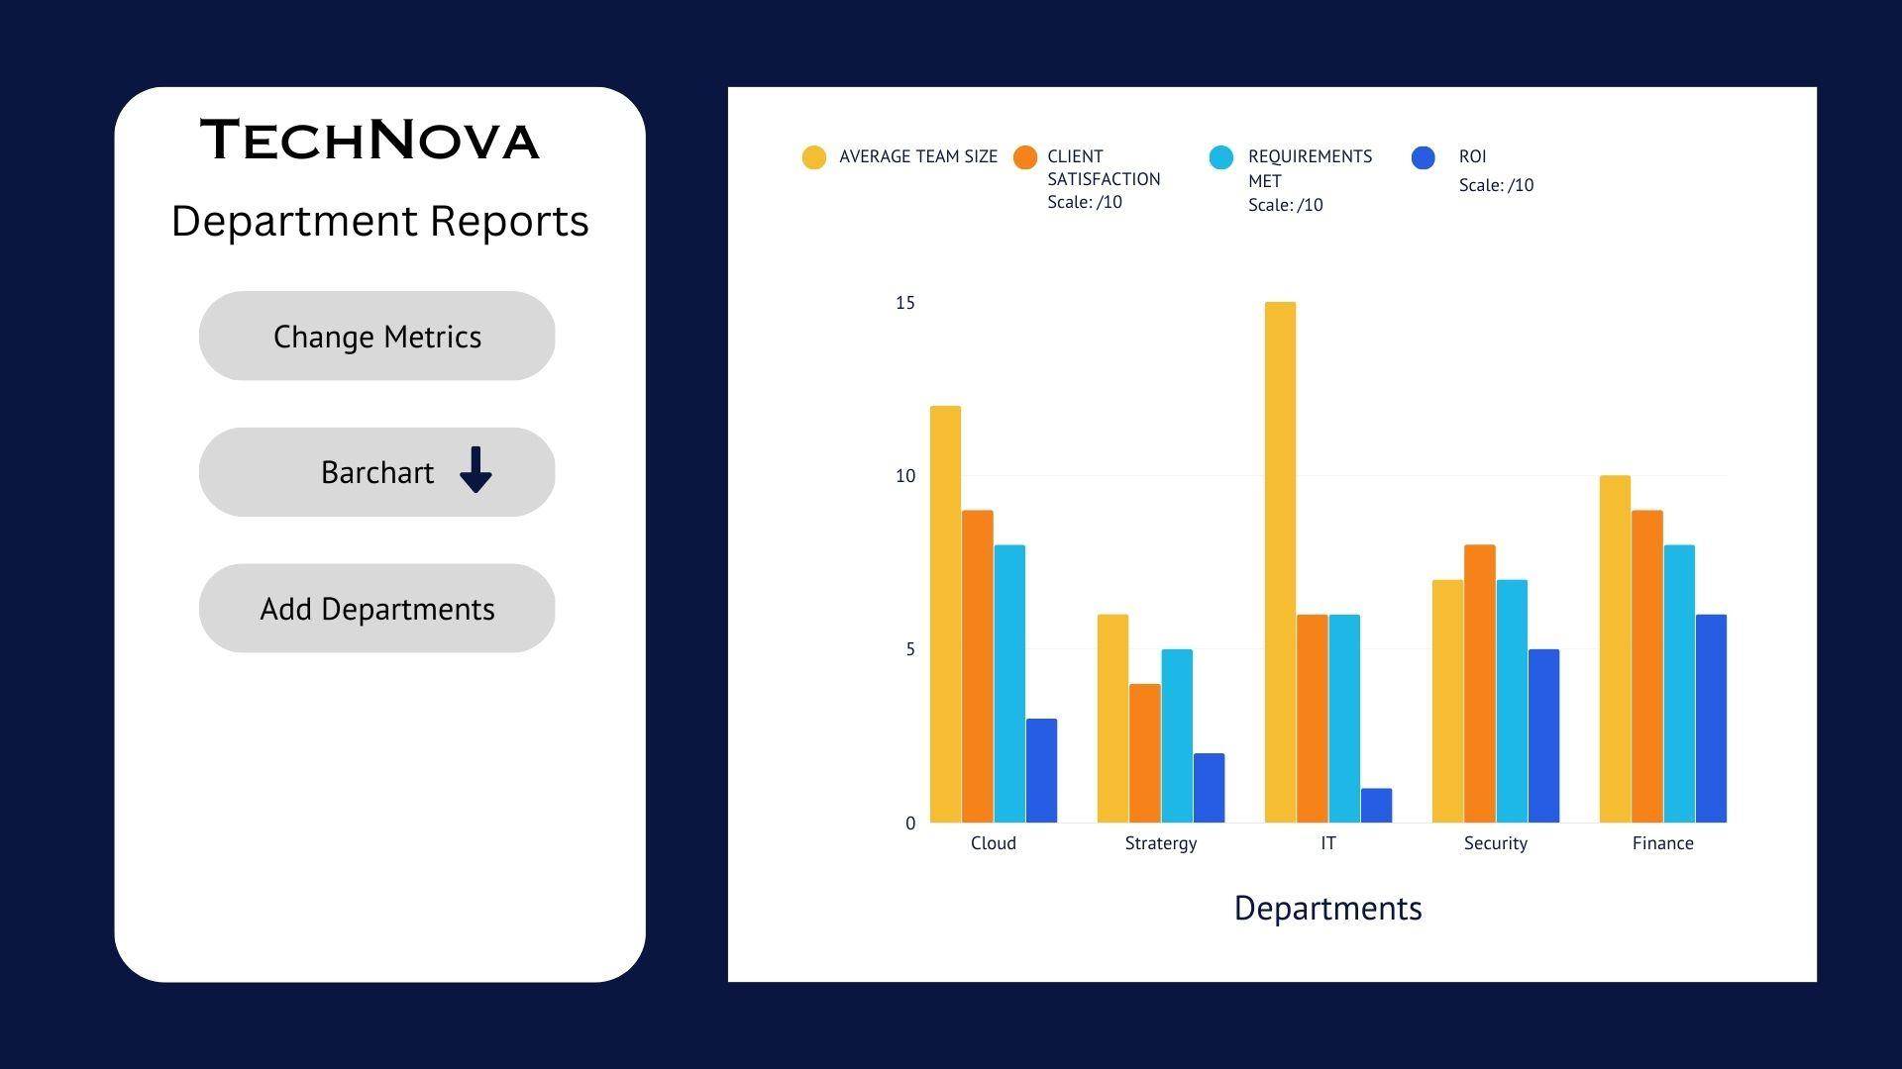
Department Metrics Interface

Slide 16
Thank You!

